Slide 1
Special Course in Software Engineering ‘24
Mini-Project Program Flow

Slide 2
my_data.csv
ENTER THE PATH TO YOUR DATASET:

Slide 3
Following are the variables in your dataset
Variable | Type | Mean / Median / Mode | Kurtosis | Skewness
Age | Ratio | 25 | 2.98 | 0.8
Name | Nominal | NA | NA | NA
Gender | Nominal | Male | NA | NA
Income | Ratio | 3454.98 | 4.5 | 1.7
Income Group | Ordinal | Medium | NA | NA
… | … | … | … | …

Slide 4
How do you want to analyze your data?
Plot variable distribution
Conduct ANOVA
Conduct t-Test
Conduct chi-Square
Conduct Regression
Conduct Sentiment Analysis
Quit
Enter your choice (1 – 7):
1

Slide 5
Following variables are available for plot distribution:
Age
Gender
Income
Income Group
…
BACK
QUIT
Enter your choice:
1

Slide 6
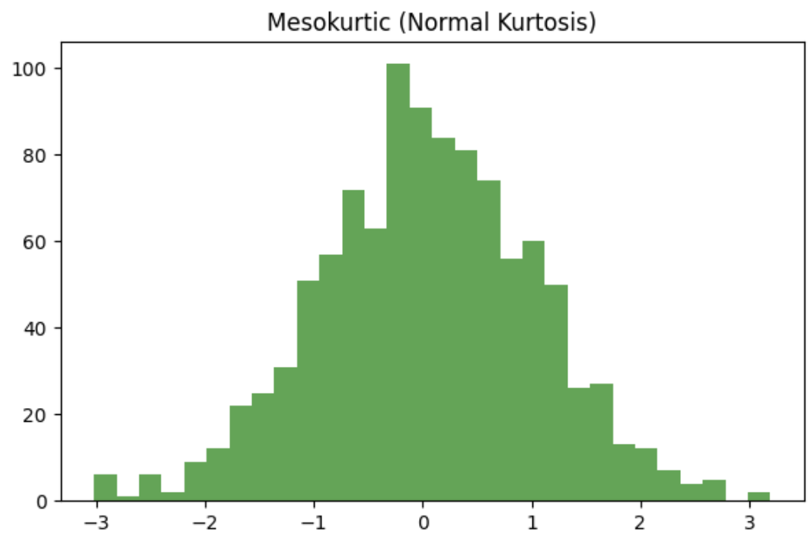
Distribution plot for ‘Age’

Slide 7
Following variables are available for plot distribution:
Age
Gender
Income
…
…
BACK
QUIT
Enter your choice:
6

Slide 8
How do you want to analyze your data?
Plot variable distribution
Conduct ANOVA
Conduct t-Test
Conduct chi-Square
Conduct Regression
Conduct Sentiment Analysis
Quit
Enter your choice (1 – 7):
2

Slide 9
For ANOVA, following are the variables available
Enter a continuous (interval/ratio) variable:
Enter a categorical (ordinal/nominal) variable:
Variable | Type
Age | Ratio
Income | Ratio
Income group | Ordinal
… | …
Age
Income group

Slide 10
….
Enter a continuous (interval/ratio) variable: Age
Enter a categorical (ordinal/nominal) variable: Income group
Performing ANOVA over the selected variables…
‘Age’ is not normally distributed, as shown in the Q-Q plot…

Slide 11
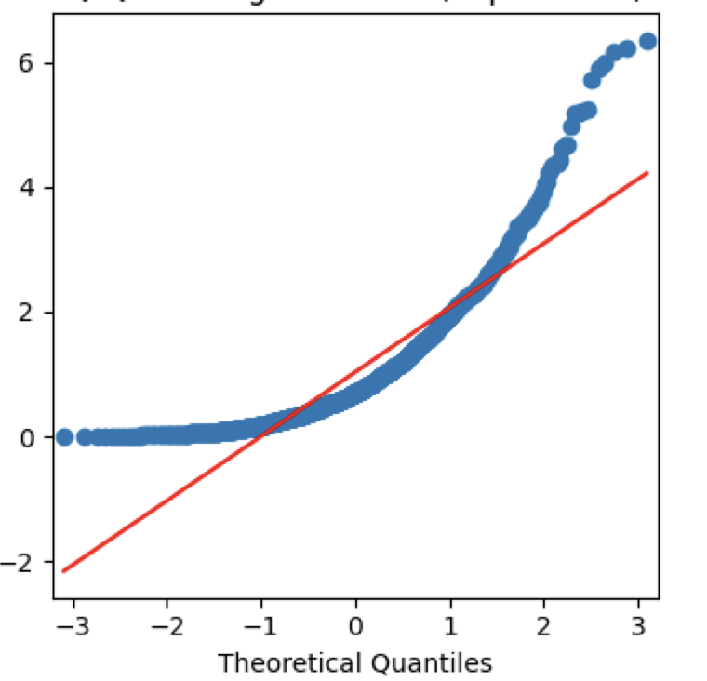

Slide 12
….
‘Age’ is not normally distributed, as shown in the Q-Q plot…
Performing Kurskal-Wallis Test instead…
Kruskal-Wallis Result:
Kruskal-Wallis Statistic: 74.457876542…
p-value: 6.9709e-05
Result is statistically significant.
Therefore, your Null Hypothesis is rejected.
There is a statistically significant difference in the average ‘Age’ across the categories of ‘Income Group’

Slide 13
How do you want to analyze your data?
Plot variable distribution
Conduct ANOVA
Conduct t-Test
Conduct chi-Square
Conduct Regression
Conduct Sentiment Analysis
Quit
Enter your choice (1 – 7):
6

Slide 14
Looking for text data in your dataset…
Sorry, your dataset does not have a suitable length text data.
Therefore, Sentiment Analysis is not possible.
Returning to previous menu…

Slide 15
How do you want to analyze your data?
Plot variable distribution
Conduct ANOVA
Conduct t-Test
Conduct chi-Square
Conduct Regression
Conduct Sentiment Analysis
Quit
Enter your choice (1 – 7):
7

Slide 16
That’s all for this lecture

